Slide 1
Decision Tree
ch
Decision Trees are machine learning algorithms used for classification and regression tasks with tabular data.

Slide 2
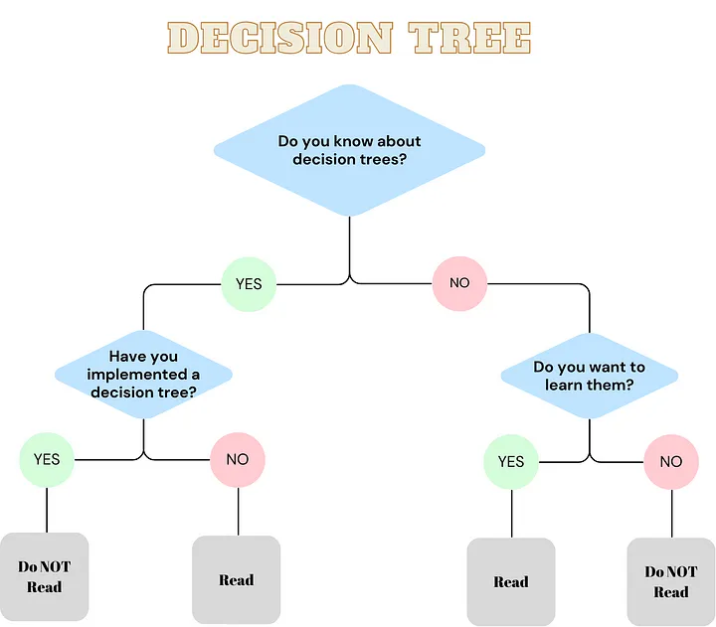
Decision Tree
Even though a basic decision tree is not widely used, there are various more sophisticated algorithms that are built on basic decision trees which are more common such as random forests and boosted trees.

Slide 3
History of Decision Tree
The history of a decision tree goes back to 1950s.
William Welson has introduced some kind of a tree structure in 1959 in his “Matching and prediction on the principle of biological classification” paper.
After than structured algorithms were proposed by Ross Quinlan (ID3, C4.5) and Leo Breiman (CART) in 1980s.
After 90s, some scientist proposed more advanced algorithms which are built upon simple decision trees.

Slide 4
Family of Decision Tree
Entropy is typically used in ID3 and C4.5 algorithms
Gini index is typically used in CART (Classification and Regression Trees) algorithms

Slide 5
Regression Tree
A regression tree is used when the dependent variable is continuous. The value obtained by leaf nodes in the training data is the mean response of observation falling in that region.
Thus, if an unseen data observation falls in that region, its prediction is made with the mean value.
This means that even if the dependent variable in training data was continuous, it will only take discrete values in the test set.
A regression tree follows a top-down greedy approach.

Slide 6
Classification Tree
A classification tree is used when the dependent variable is categorical.
The value obtained by leaf nodes in the training data is the mode response of observation falling in that region It follows a top-down greedy approach.
Together they are called as CART(classification and regression tree)

Slide 7
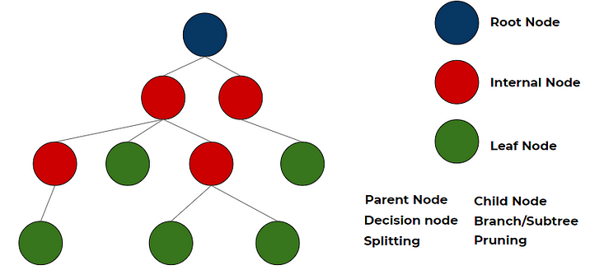

Slide 8
Types of Decision Tree
Regression Tree
Classification Tree

Slide 9
Decide What is a Good Split
The main idea for training a decision tree is about how you will split your data. The best split is basically a split where after spliting each split has data points where every data point has the same class.

Slide 10
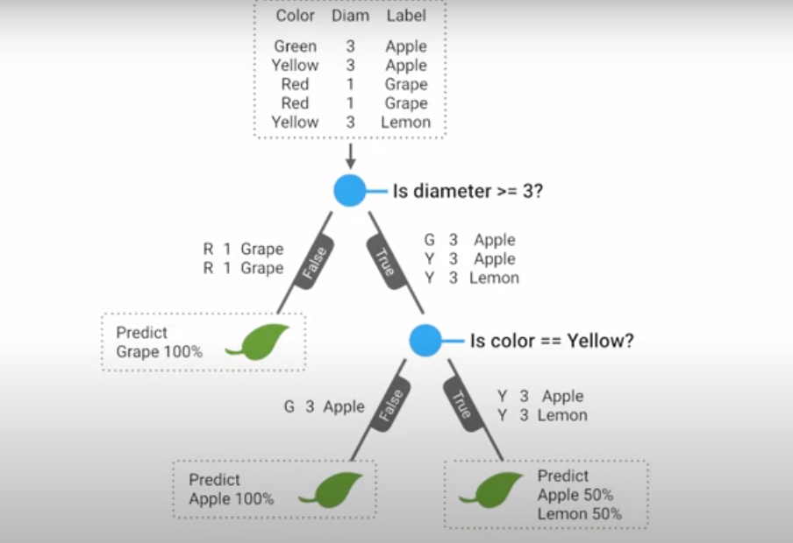
Good split consider by
The
Gini Index
Entropy

Slide 11


Aspect | Entropy (Information Gain) | Gini Index
Formula
Range (Binary Case) | 0 → 1 | 0 → 0.5
Interpretation | Measures "information content" (uncertainty). | Measures "impurity" (probability of misclassification).
Bias | Biased toward splits that produce smaller, balanced branches. | Biased toward splits that isolate the most frequent class.
Computation | More computationally expensive (needs log). | Faster (only squares).
Used in | ID3, C4.5, C5.0 decision tree algorithms. | CART (Classification and Regression Trees).

Slide 12
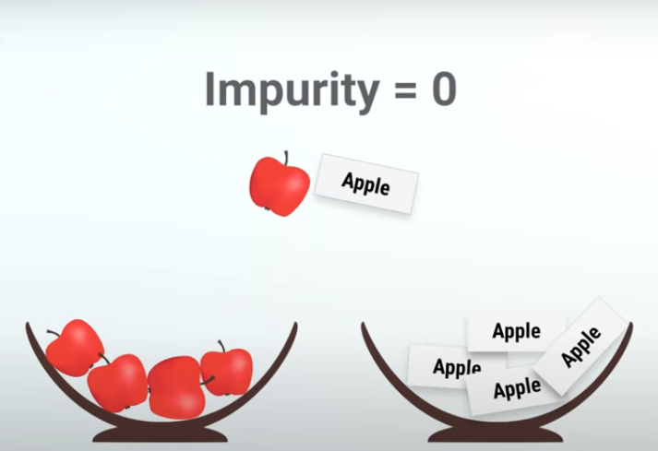
The Best question is one that reduce our uncertainty

Slide 13
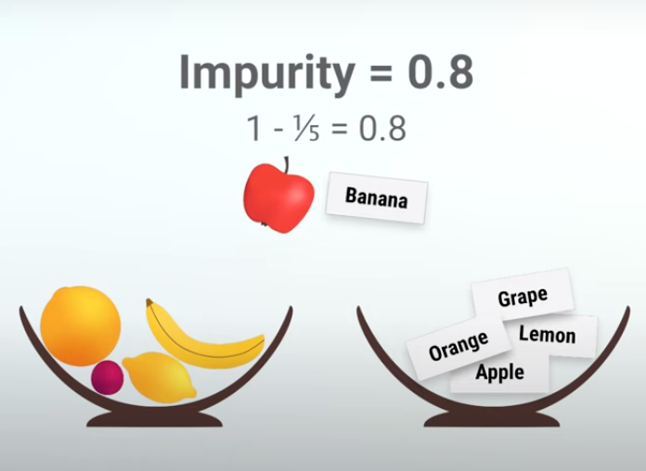

Slide 14
Information Gain
Information gain is a measure used to determine which feature should be used to split the data at each internal node of the decision tree.
Information Gain is a measure used in Decision Trees (especially with Entropy) to decide which feature gives the best split.
It tells us how much "uncertainty" (entropy) is reduced when we split a dataset based on a particular feature.
Intuition:
High Information Gain → feature creates pureer child nodes (better split).
Low Information Gain → feature doesn’t reduce much uncertainty.

Slide 15
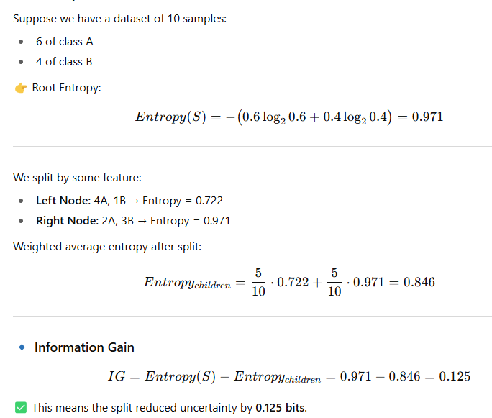
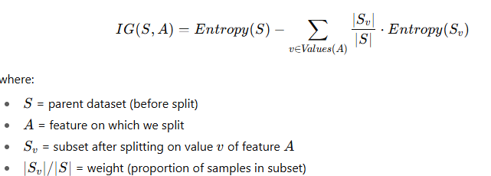

Slide 16
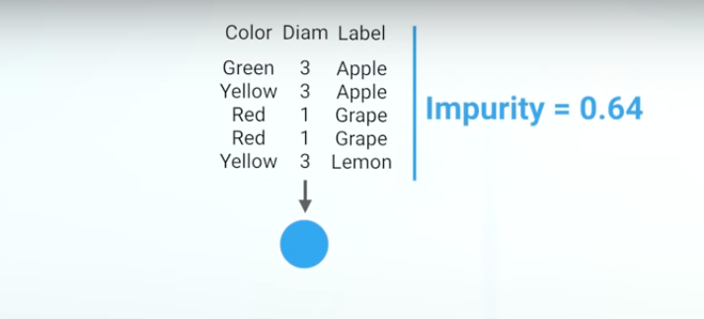

Slide 17
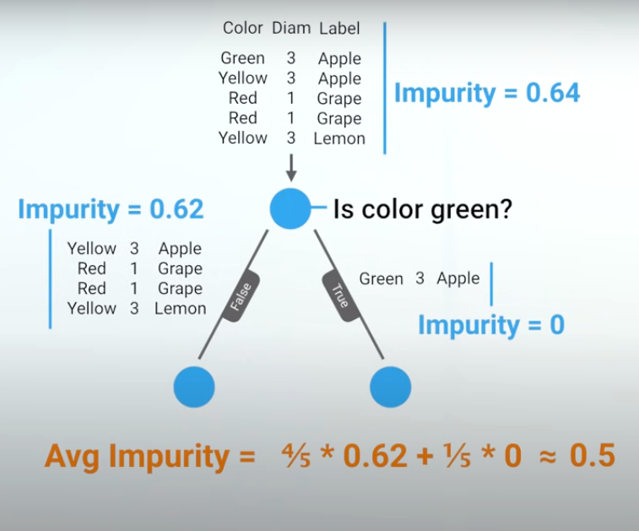
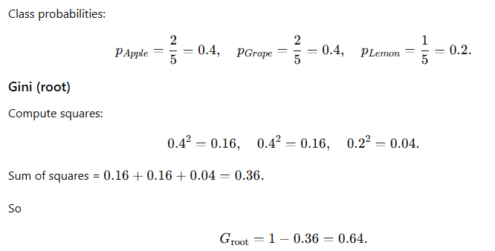
Gini impurity

Slide 18
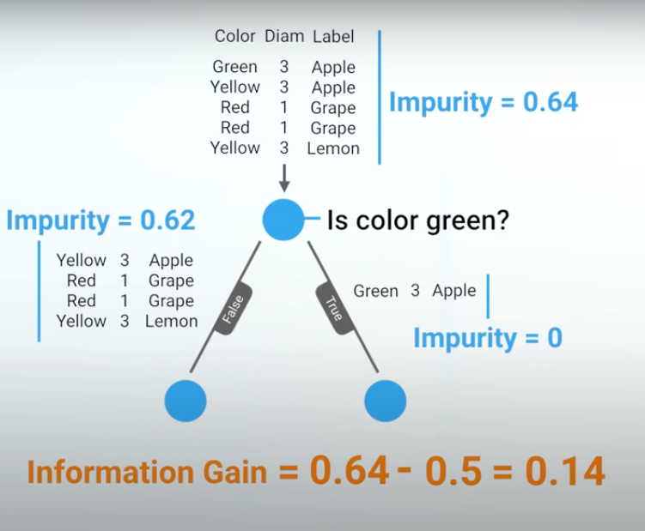

Slide 19
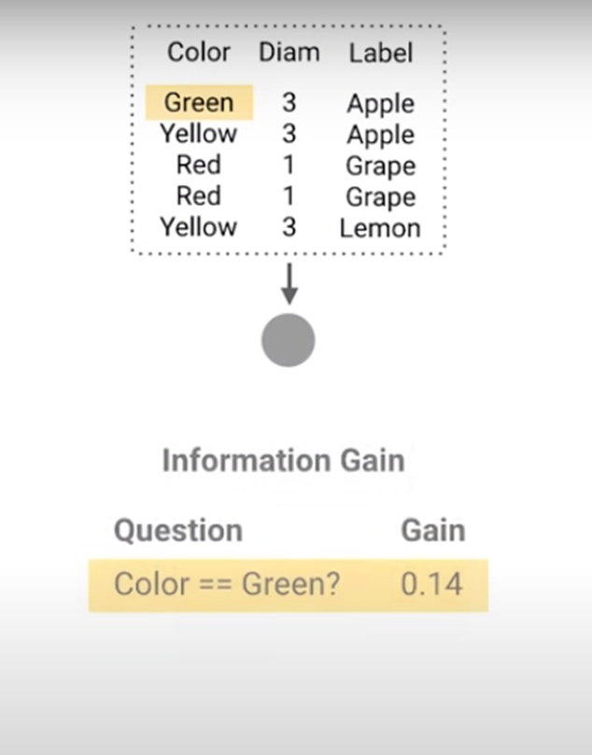

Slide 20
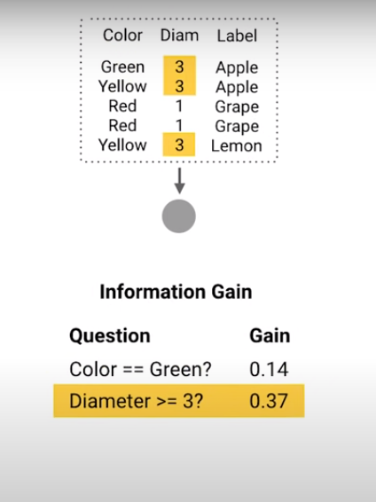

Slide 21
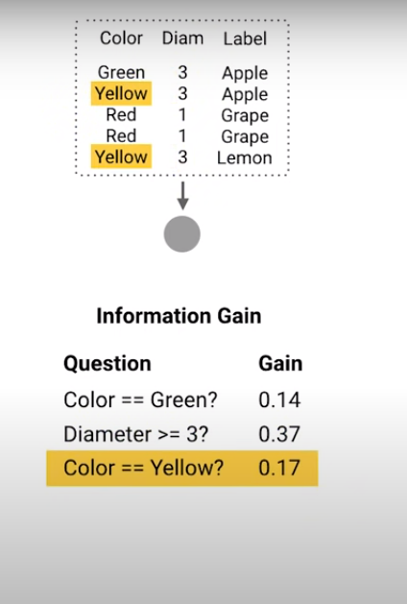

Slide 22
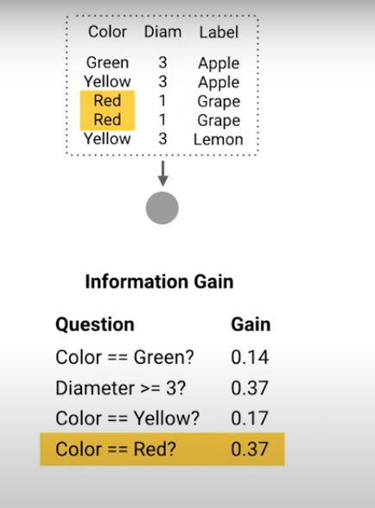

Slide 23
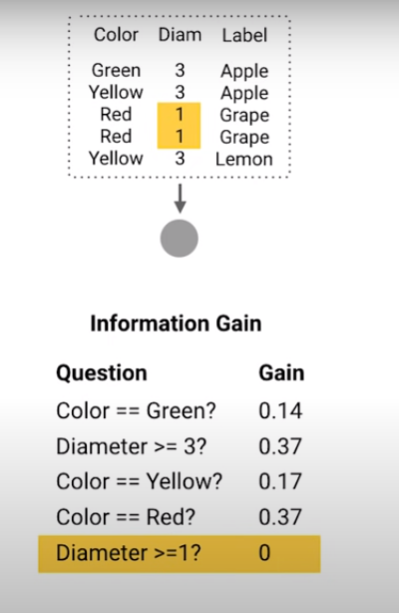

Slide 24
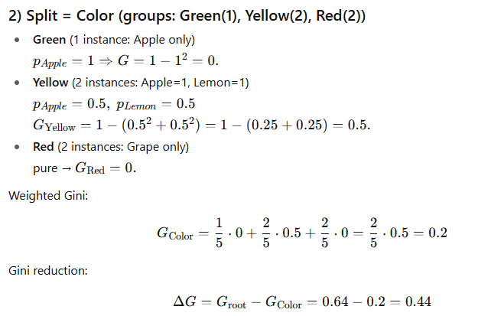

Slide 25
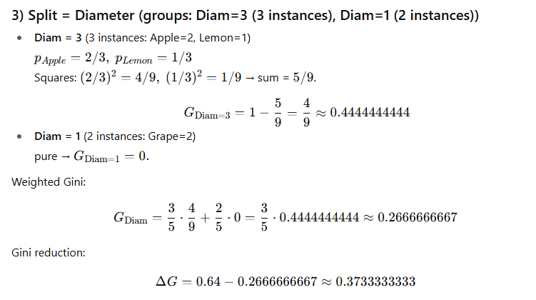

Slide 26
Gini Impurity is default metric in CART
Gini says, if we select two items from a population at random then they must be of the same class and the probability for this is 1 if the population is pure.
It works with the categorical target variable “Success” or “Failure”.
It performs only Binary splits
Higher the value of Gini higher the homogeneity.
CART (Classification and Regression Tree) uses the Gini method to create binary splits.

Slide 27
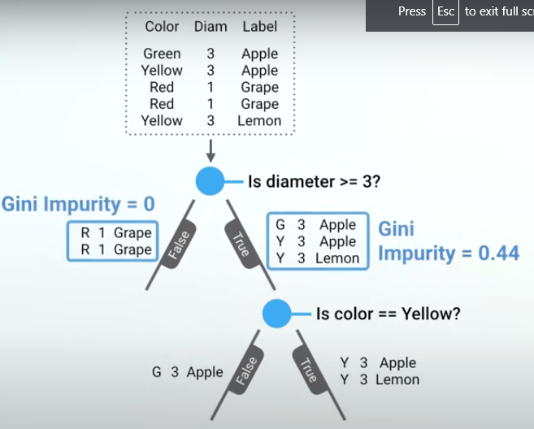

Slide 28
Gini impurity
Range: Gini impurity values range from 0 to 0.5.
0: Represents perfect purity, meaning all data points in the node belong to the same class.
0.5: Represents maximum impurity, indicating an equal distribution of classes in the node (completely mixed).
Interpretation: A lower Gini impurity signifies a better split in the decision tree. This is because it means the data is more separated into its correct classes after the split, leading to a more accurate decision tree.

Slide 29
How it works:
Imagine you're building a decision tree to classify emails as spam or not spam.
Gini impurity is calculated at each node of the tree to decide the best way to split the data.
Here's the formula:
Gini impurity = 1 - Σ (pi)^2
Σ (sigma) represents the sum over all classes (e.g., spam and not spam)pi
(pi) represents the probability of class i occurring in that node

Slide 30
Example:
Let's say you have a node with 6 emails: 3 spam and 3 not spam.
Probability of Spam (p(Spam)) = 3/6 = 0.5
Probability of Not Spam (p(Not Spam)) = 3/6 = 0.5
Gini impurity = 1 - (3/6)2 - (3/6)2 = 0.5
This indicates perfect purity (Gini impurity = 0) because all emails in the node belong to the same class proportion (50% spam and 50% not spam).
Gini impurity is a measure of how "pure" a node is in terms of its classification. A node with all instances belonging to the same class has a Gini impurity of 0, while a node with an equal number of instances from different classes has a Gini impurity of 0.5.

Slide 31
1. Gini Index
The Gini index is the name of the cost function used to evaluate splits in the dataset.
A split in the dataset involves one input attribute and one value for that attribute. It can be used to divide training patterns into two groups of rows.
A Gini score gives an idea of how good a split is by how mixed the classes are in the two groups created by the split.
A perfect separation results in a Gini score of 0, whereas the worst case split that results in 50/50 classes in each group result in a Gini score of 0.5 (for a 2 class problem).

Slide 32
Calculating Gini is best demonstrated with an example.
We have two groups of data with 2 rows in each group.
The rows in the first group all belong to class 0 and the rows in the second group belong to class 1, so it’s a perfect split.
proportion = count(class_value) / count(rows)
group_1_class_0 = 2 / 2 = 1
group_1_class_1 = 0 / 2 = 0
group_2_class_0 = 0 / 2 = 0
group_2_class_1 = 2 / 2 = 1

Slide 33
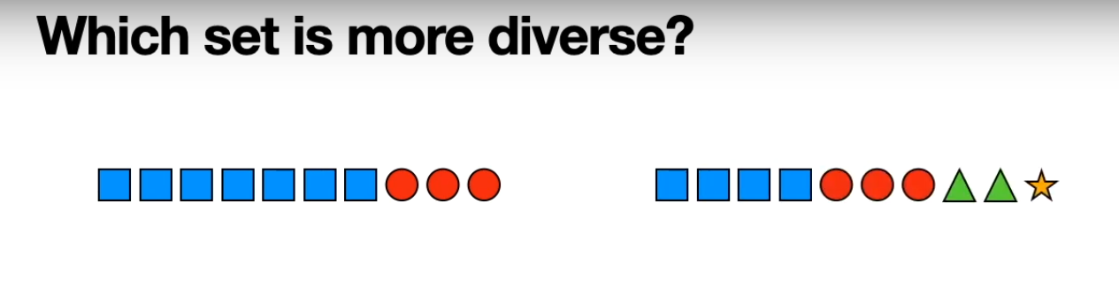

Slide 34
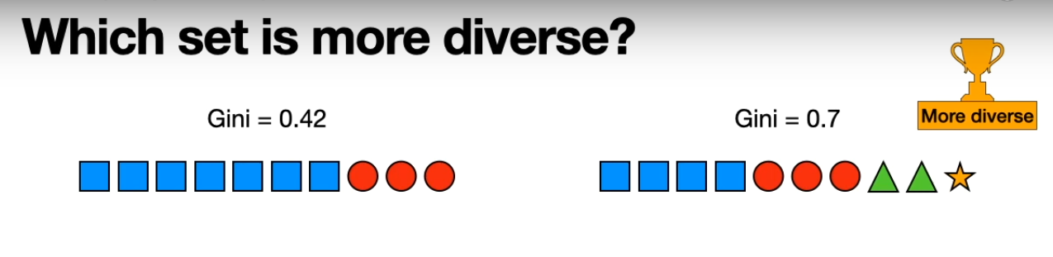

Slide 35
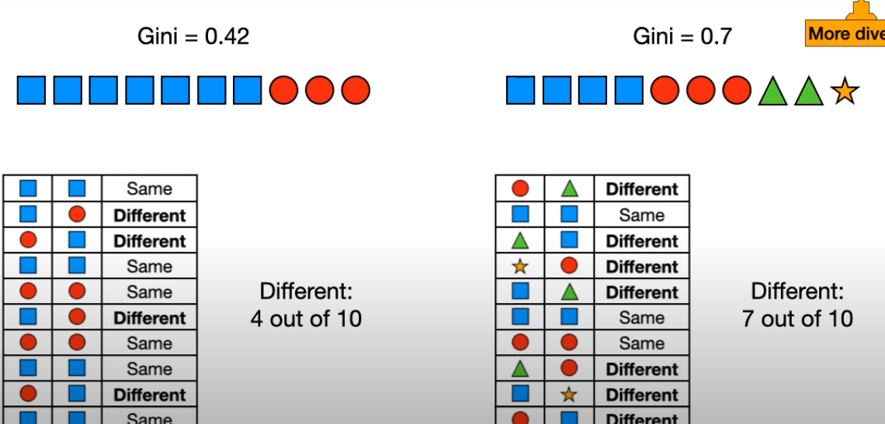

Slide 36
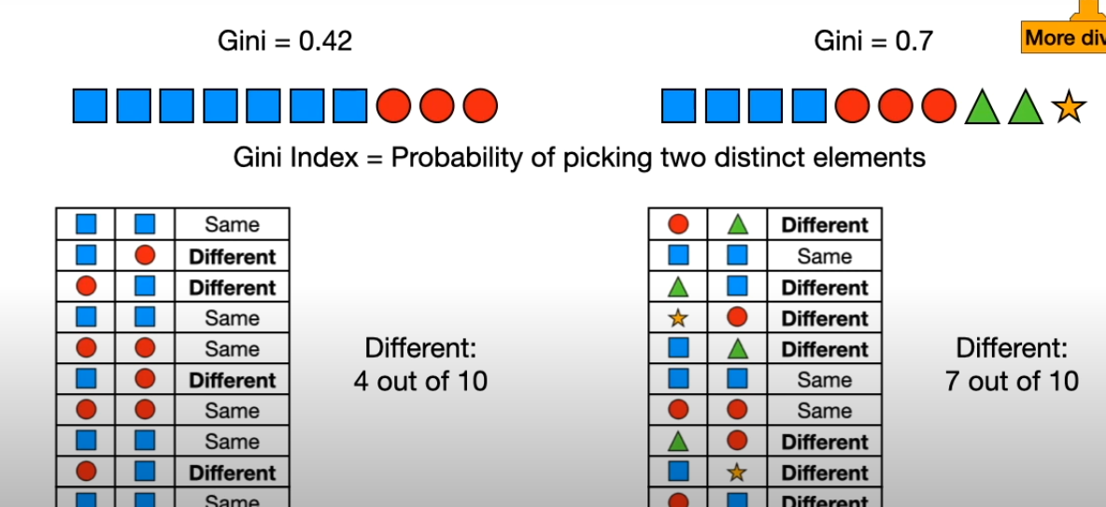

Slide 37
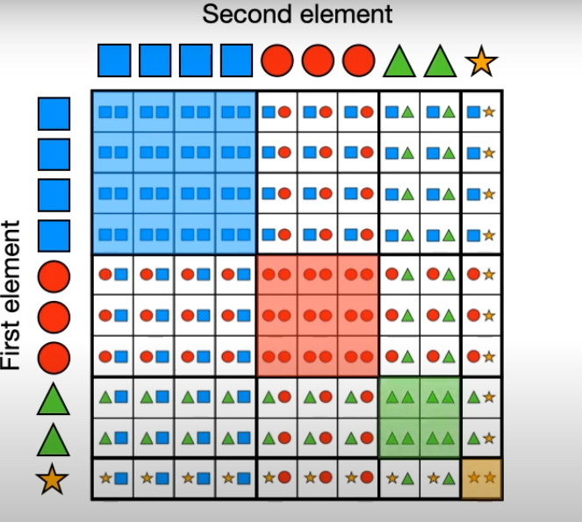

Slide 38
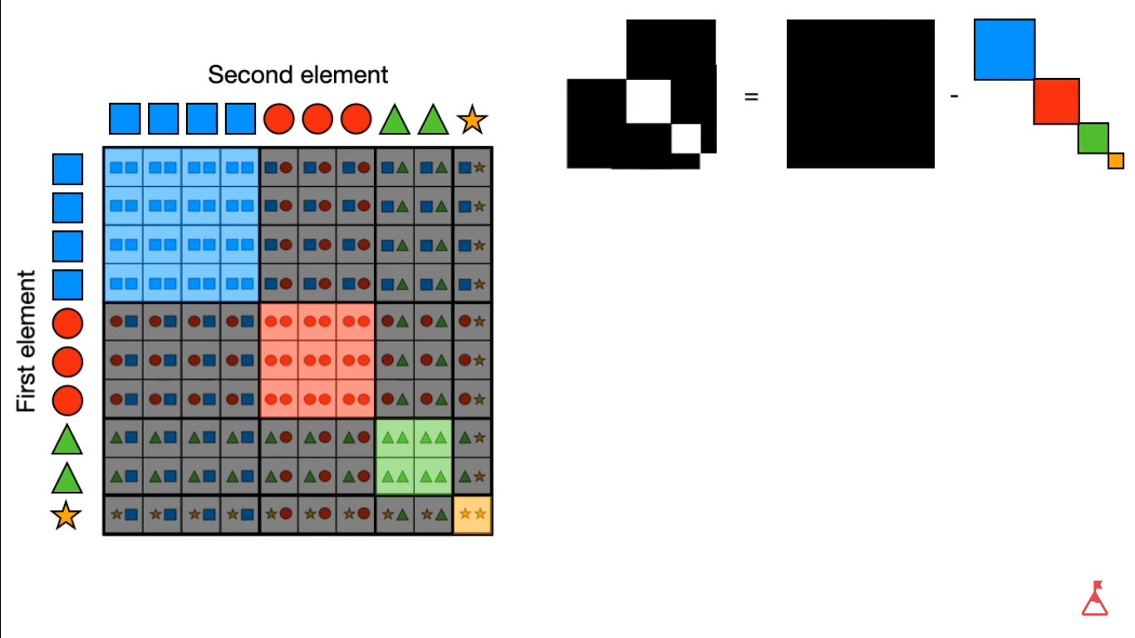

Slide 39
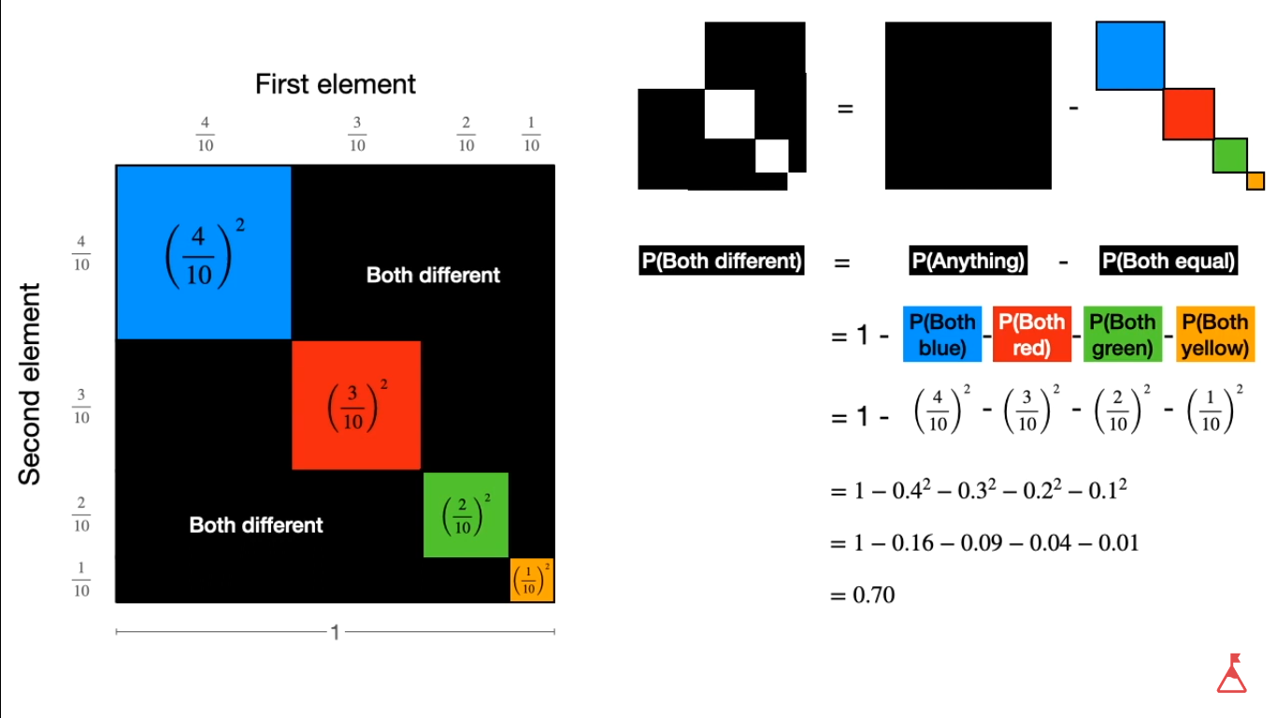
Notes:
https://www.youtube.com/watch?v=u4IxOk2ijSs

Slide 40
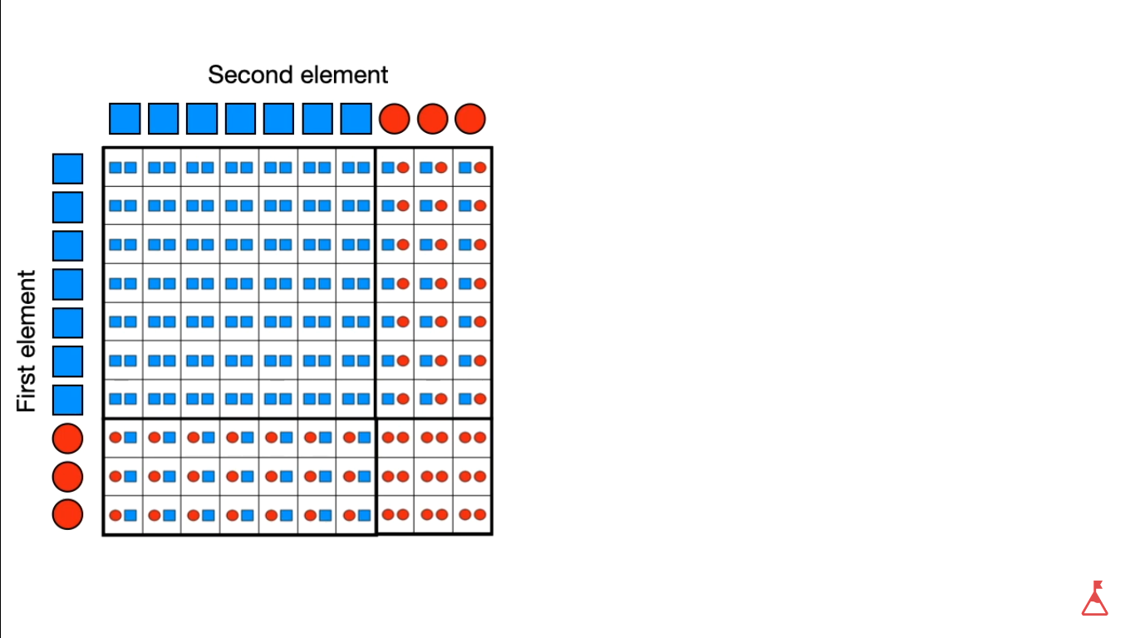

Slide 41
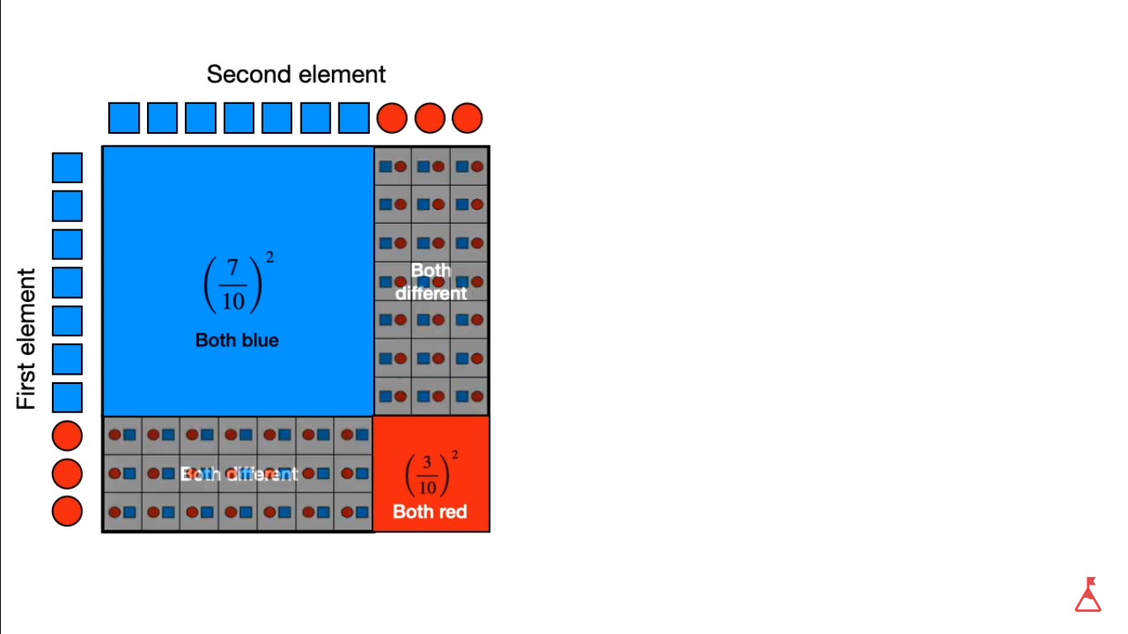

Slide 42
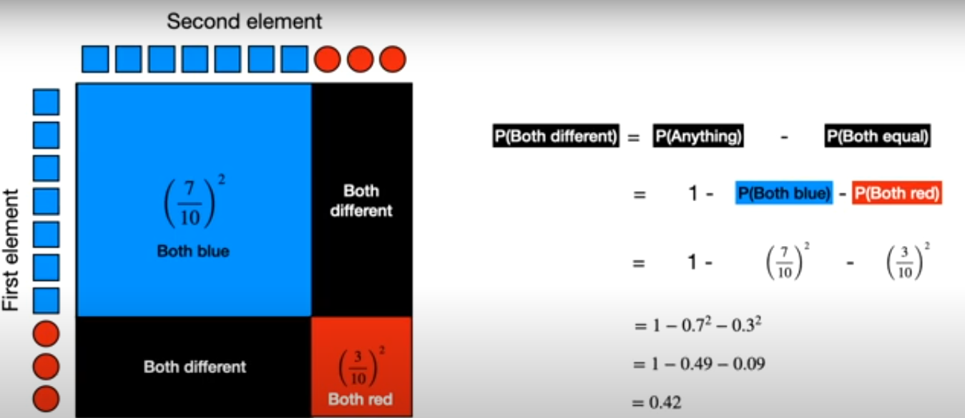

Slide 43
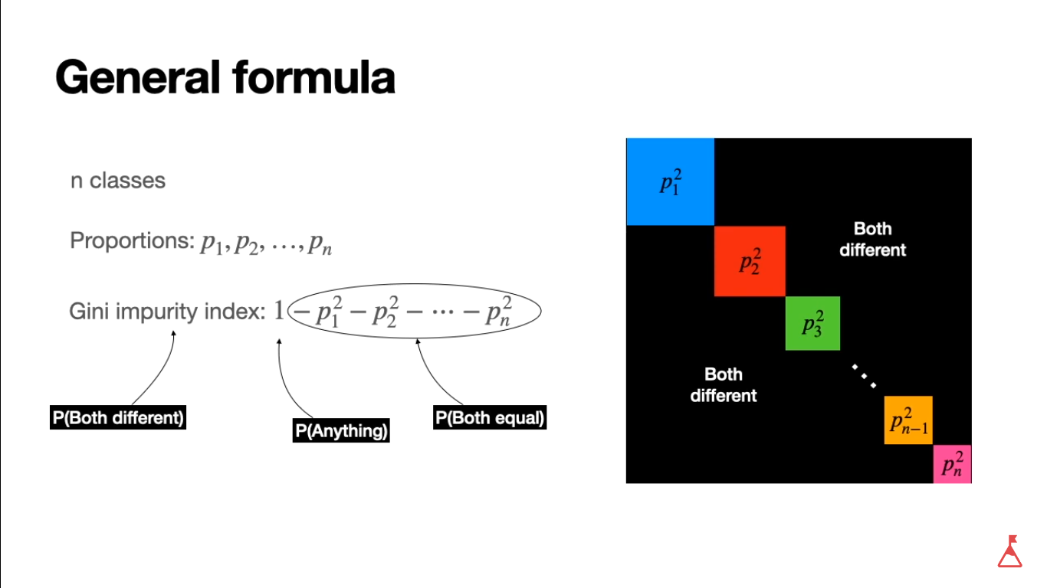

Slide 44
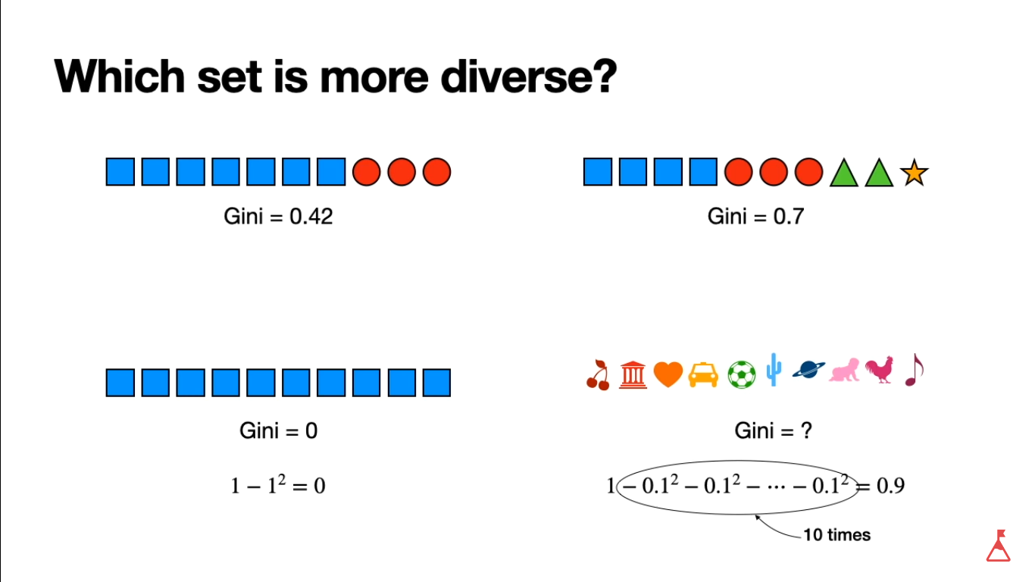

Slide 45
Let’s take an example.
Imagine you're classifying emails as spam or not spam based on two features: sender (known or unknown) and urgency (high or low). Here's the data:

Slide 46
Dataset
Sender | Urgency | Spam
Known | High | No
Known | Low | No
Unknown | High | Yes
Unknown | Low | No
Unknown | High | Yes
Unknown | Low | Yes
Gini Index: It measures how impure a node is, or how likely a random instance is misclassified.
A Gini index of 0 means perfect purity (all instances belong to one class), while 0.5 represents maximum impurity (equal distribution between classes).

Slide 47
Consider splitting by Sender:
Left Node (Known Sender): 2 No Spam emails (probability of misclassification = 0 for spam, 0 for not spam)
Right Node (Unknown Sender): 3 emails (1 Spam, 2 Not Spam) - Gini for Right Node = 1 - (4/9)^2 - (5/9)^2 = 0.444
Weighted Gini (considering both left and right nodes): (2/6 * 0) + (4/6 * 0.444) = 0.296

Slide 48
Consider splitting by Urgency:
Left Node (High Urgency): 2 emails (1 Spam, 1 Not Spam) - Gini = 1 - (1/2)^2 - (1/2)^2 = 0.5
Right Node (Low Urgency): 4 emails (2 Spam, 2 Not Spam) - Gini = 1 - (1/2)^2 - (1/2)^2 = 0.5

Slide 49
Choosing the Best Split:
We compare the weighted Gini for each split.
In this case, splitting by Sender (0.296) has a lower Gini index than splitting by Urgency (0.5), so it's the better split.
This means the decision tree will first ask "Is the sender known?

Slide 50
Entropy Matrix
Entropy measures the randomness or uncertainty in a set of data. In decision trees, it tells us how mixed up the classes are at a particular node. A higher entropy indicates more uncertainty about the class label.
Calculating Entropy:
We use the following formula for Entropy (H):
H = Σ (-pi * log2(pi))
where:
Σ (sigma) represents the sum over all classes (Spam and Not Spam in this case)
pi (pi) represents the probability of class i occurring

Slide 51
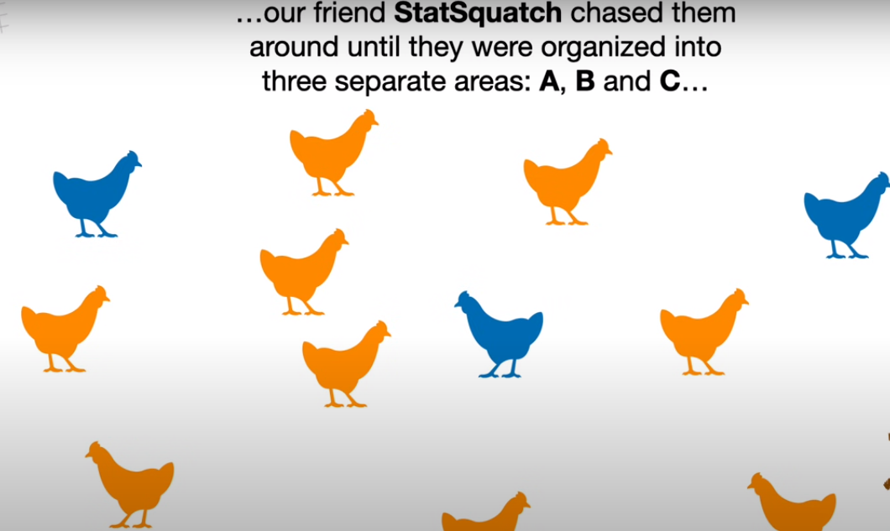

Slide 52
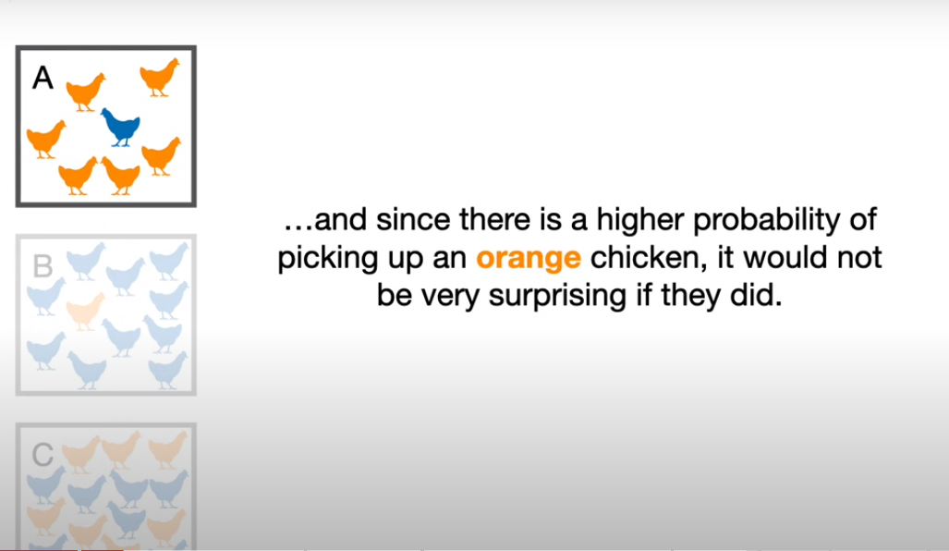

Slide 53
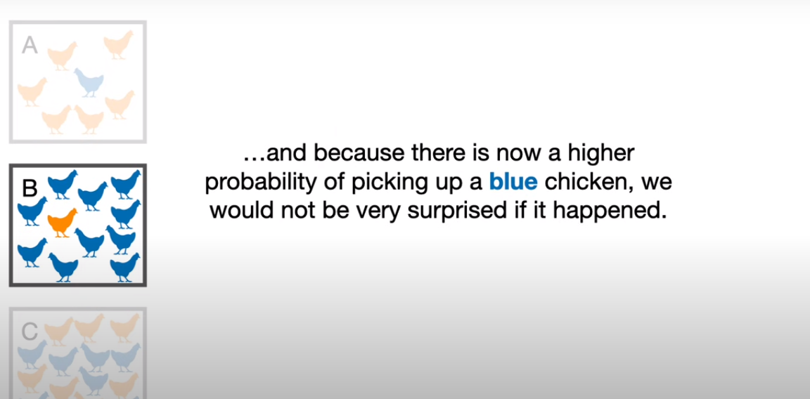

Slide 54
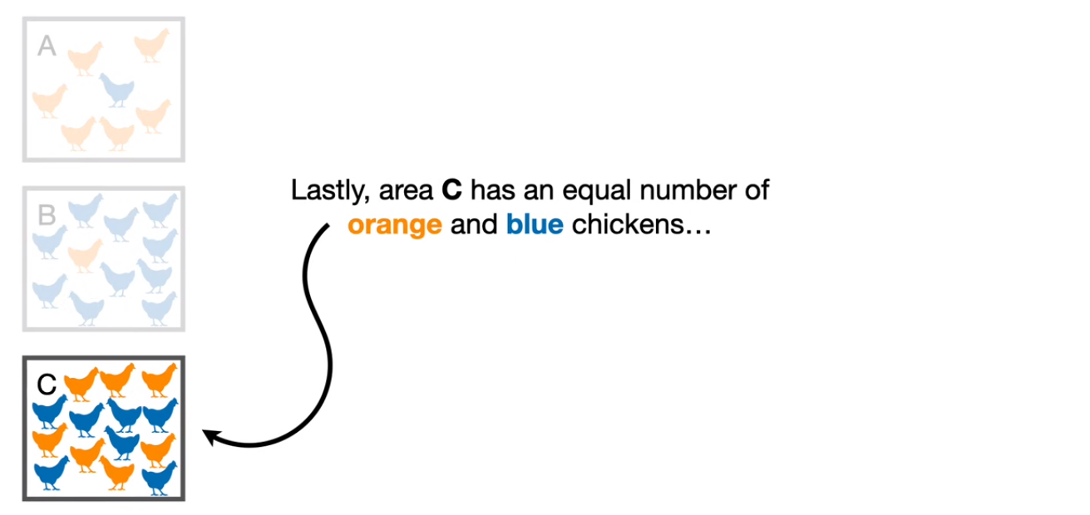

Slide 55
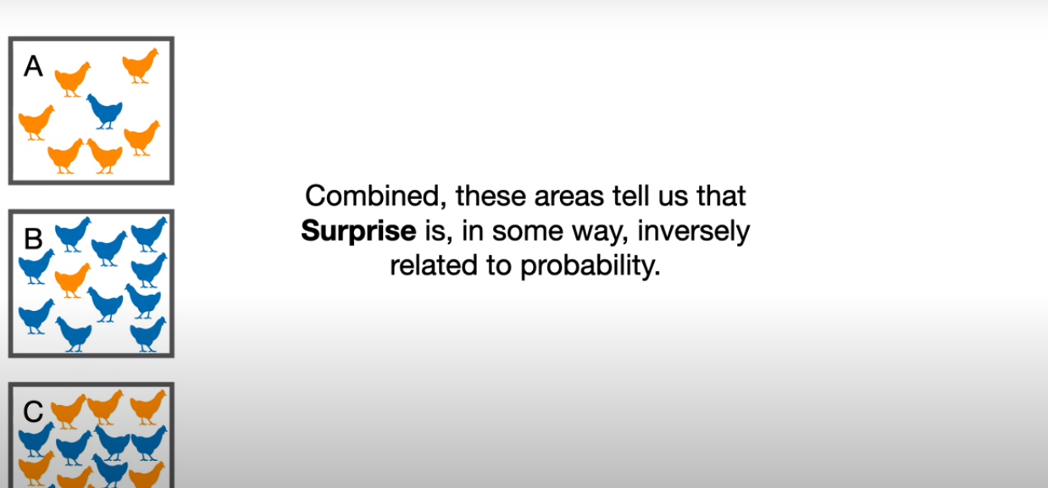

Slide 56
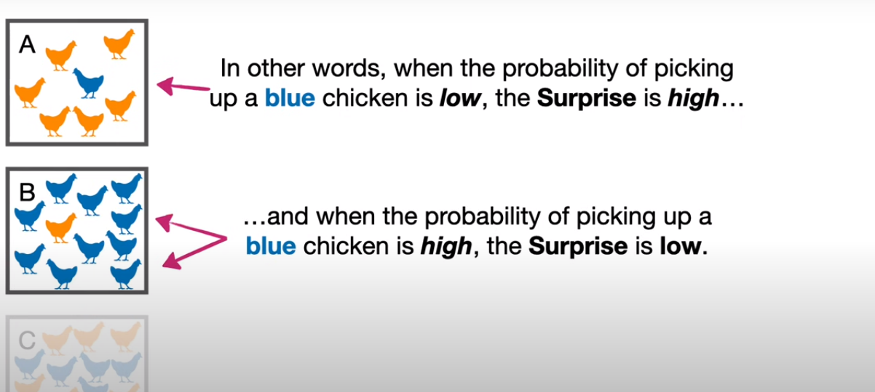

Slide 57
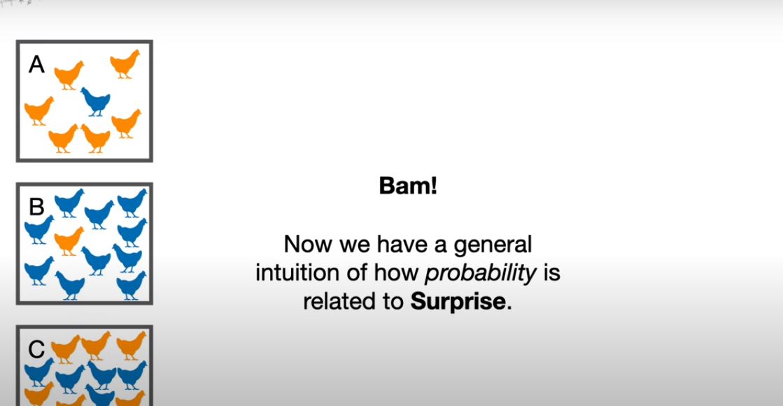

Slide 58
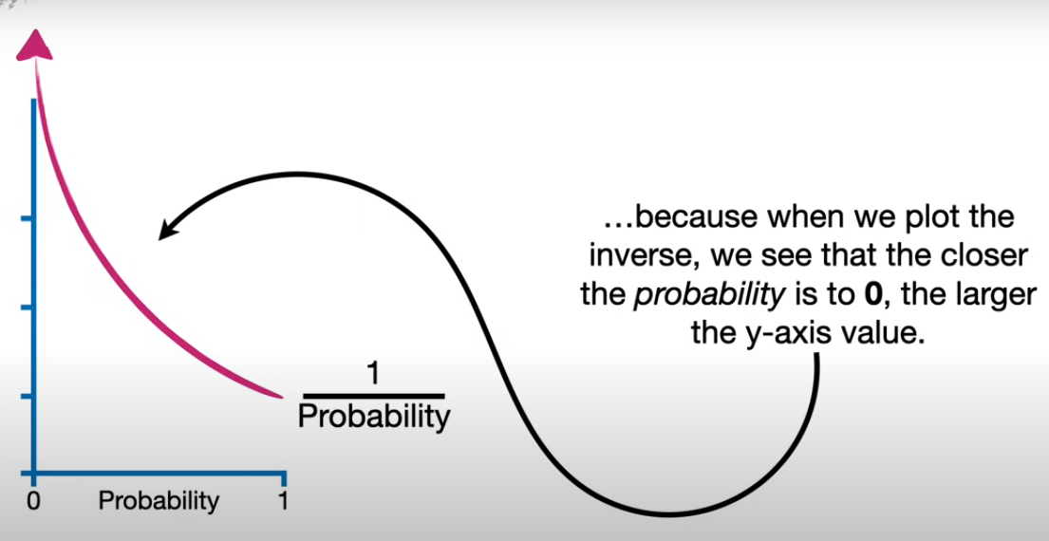

Slide 59
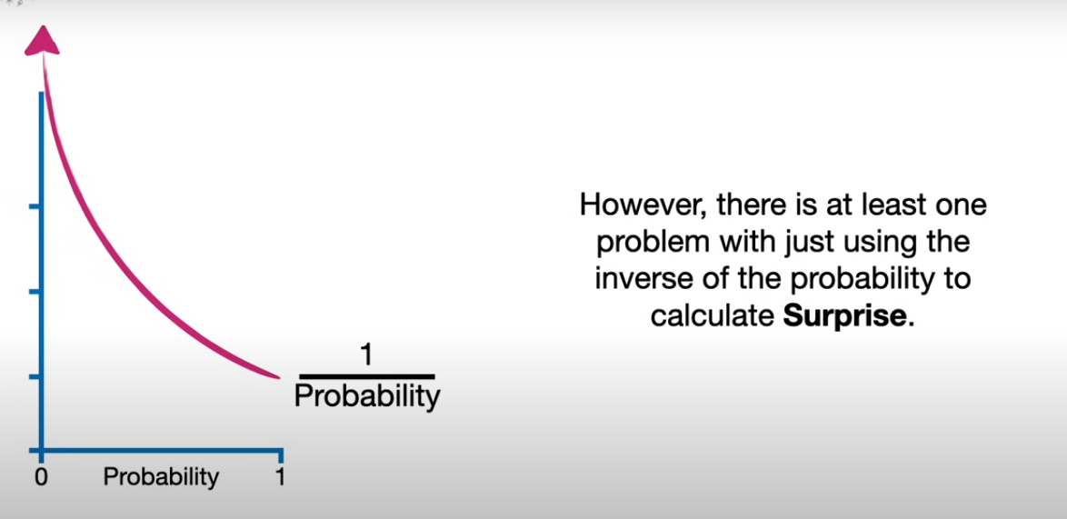

Slide 60
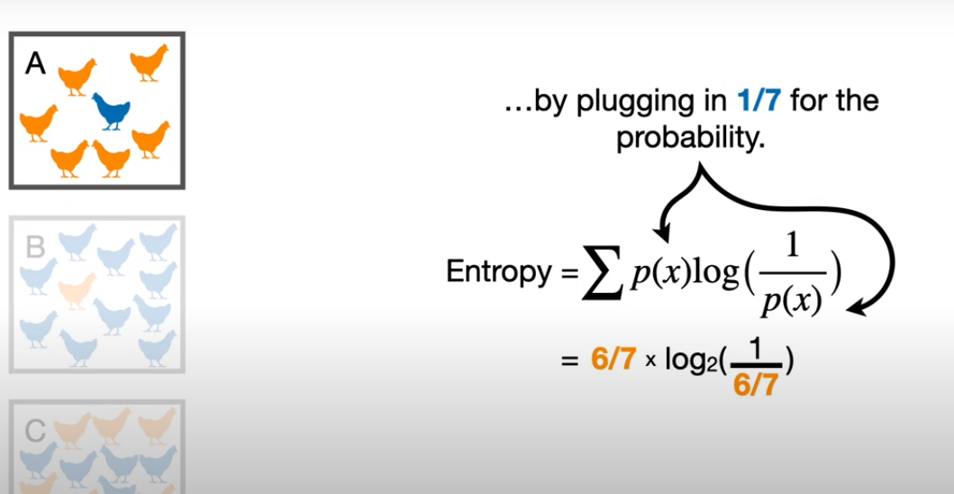

Slide 61
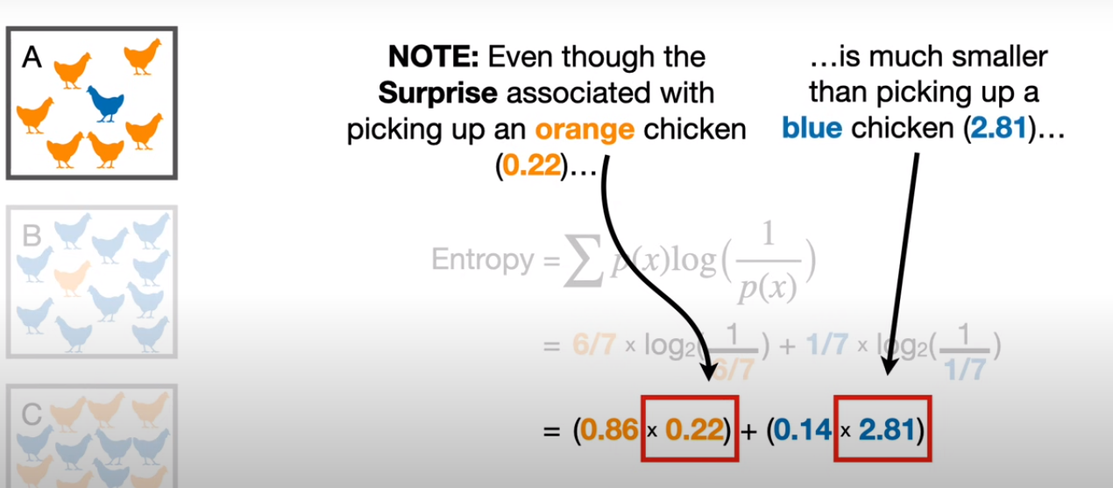
=0.59

Slide 62
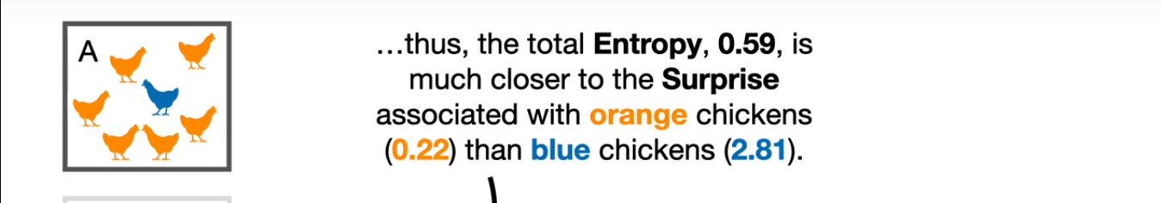

Slide 63
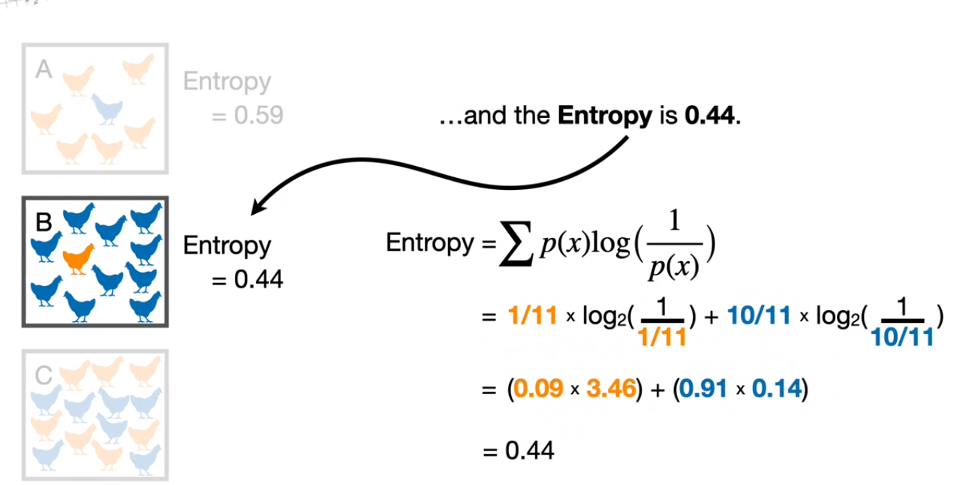

Slide 64
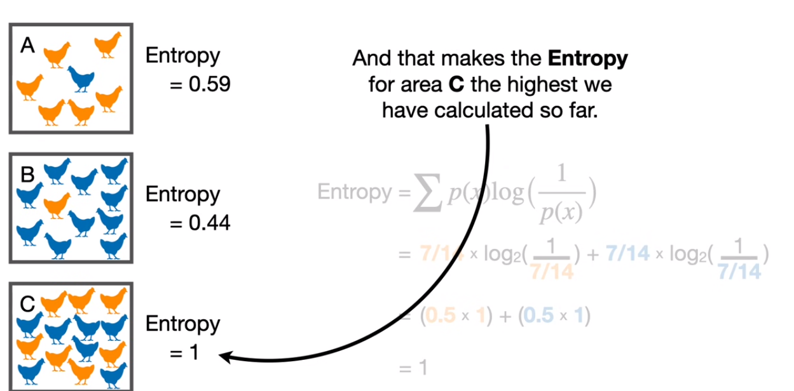

Slide 65
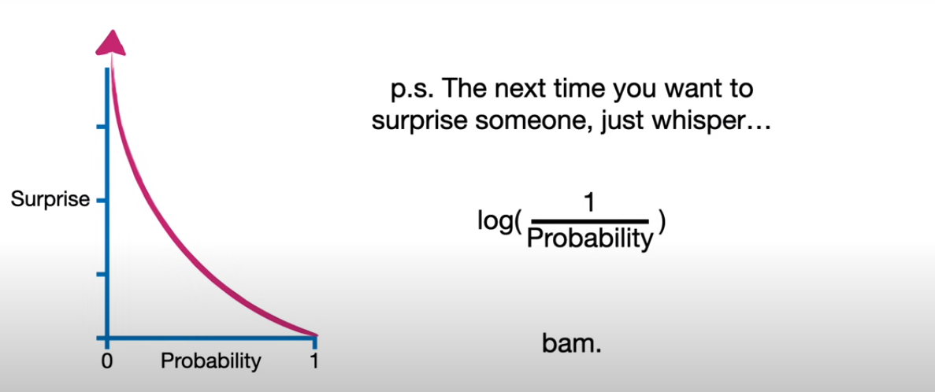

Slide 66
Math for entropy calculation in python
import math
# probability of class "buy"
p_buy = 0.40
# probability of class "not buy"
p_not_buy = 0.60
# calculate entropy
entropy = -(p_buy * math.log2(p_buy) + p_not_buy * math.log2(p_not_buy))
print(entropy)

Slide 67
Sklearn for Entropy
from sklearn.metrics import entropy
# probabilities of each class
probabilities = [0.40, 0.60]
# calculate entropy
entropy = entropy(probabilities)
print(entropy)

Slide 68
Calculating Entropy for the Root Node:
There are 3 emails classified as Spam and 3 as Not Spam (total 6). So, probabilities for each class are:
P(Spam) = 3/6 = 0.5
P(Not Spam) = 3/6 = 0.5
Now, let's calculate the entropy:
H = -(0.5 * log2(0.5)) - (0.5 * log2(0.5)) = 1 (because log2(1) = 0)
This means the root node has the maximum entropy (1) as the classes (Spam and Not Spam) are equally distributed.

Slide 69
Finding the Best Split using Entropy:

Slide 70
Splitting by Sender:
Left Node (Known Sender):
2 No Spam emails (entropy = 0, as all are Not Spam)
Right Node (Unknown Sender): 4 emails (1 Spam, 3 Not Spam)
Calculate entropy for Right Node:
P(Spam) = 1/4 = 0.25
P(Not Spam) = 3/4 = 0.75
H = - (0.25 * log2(0.25)) - (0.75 * log2(0.75)) = 0.811
Weighted Entropy (considering both left and right nodes):
(2/6 * 0) + (4/6 * 0.811) = 0.537

Slide 71
Splitting by Urgency:
Left Node (High Urgency): 2 emails (1 Spam, 1 Not Spam) - Entropy (H) = 1 (equal split)
Right Node (Low Urgency): 4 emails (2 Spam, 2 Not Spam) - Entropy (H) = 1 (equal split)
Weighted Entropy: (2/6 * 1) + (4/6 * 1) = 2/3 (0.667)

Slide 72
Choosing the Best Split:
We compare the weighted entropy for each split.
Splitting by Sender (0.537) has lower entropy than splitting by Urgency (0.667).

Slide 73
Is the sender known?" because it reduces the overall uncertainty (entropy) about the email being spam.

Slide 74
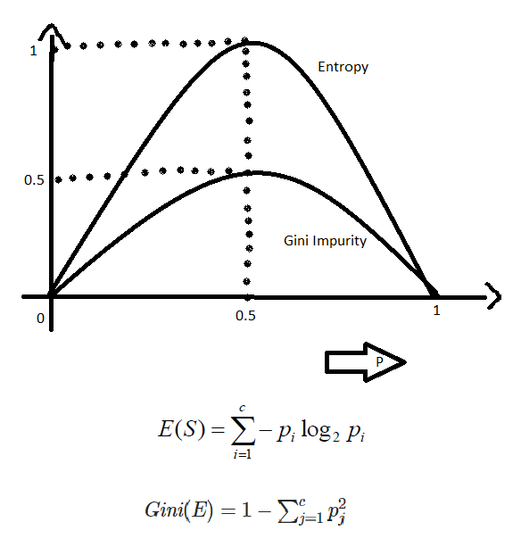
Entropy v/s Gini Impurity:
Now we have learned about Gini Impurity and Entropy and how it actually works.
Also, we have seen how we can calculate Gini Impurity/Entropy for a split/feature.
But the major question that arises here is why do we need to have both methods for computation and which is better.

Slide 75
The internal working of both methods is very similar and both are used for computing the feature/split after every new splitting. But if we compare both methods then Gini Impurity is more efficient than entropy in terms of computing power.
As you can see in the graph for entropy, it first increases up to 1 and then starts decreasing, but in the case of Gini impurity it only goes up to 0.5 and then it starts decreasing, hence it requires less computational power.
The range of Entropy lies in between 0 to 1 and the range of Gini Impurity lies between 0 to 0.5. Hence we can conclude that Gini Impurity is better as compared to entropy for selecting the best features.

Slide 76
It is the probability of misclassifying a randomly chosen element in a set. | While entropy measures the amount of uncertainty or randomness in a set.
The range of the Gini index is [0, 1], where 0 indicates perfect purity and 1 indicates maximum impurity. | The range of entropy is [0, log(c)], where c is the number of classes.
Gini index is a linear measure. | Entropy is a logarithmic measure.
It can be interpreted as the expected error rate in a classifier. | It can be interpreted as the average amount of information needed to specify the class of an instance.
It is sensitive to the distribution of classes in a set. | It is sensitive to the number of classes.
The computational complexity of the Gini index is O(c). | Computational complexity of entropy is O(c * log(c)).

Slide 77
It is less robust than entropy. | It is more robust than Gini index.
It is sensitive. | It is comparatively less sensitive.
Formula for the Gini index is Gini(P) = 1 – ∑(Px)^2 , where Pi is the proportion of the instances of class x in a set. | Formula for entropy is Entropy(P) = -∑(Px)log(Px), where pi is the proportion of the instances of class x in a set.
It has a bias toward selecting splits that result in a more balanced distribution of classes. | It has a bias toward selecting splits that result in a higher reduction of uncertainty.
Gini index is typically used in CART (Classification and Regression Trees) algorithms | Entropy is typically used in ID3 and C4.5 algorithms

Slide 78
